Slide 1

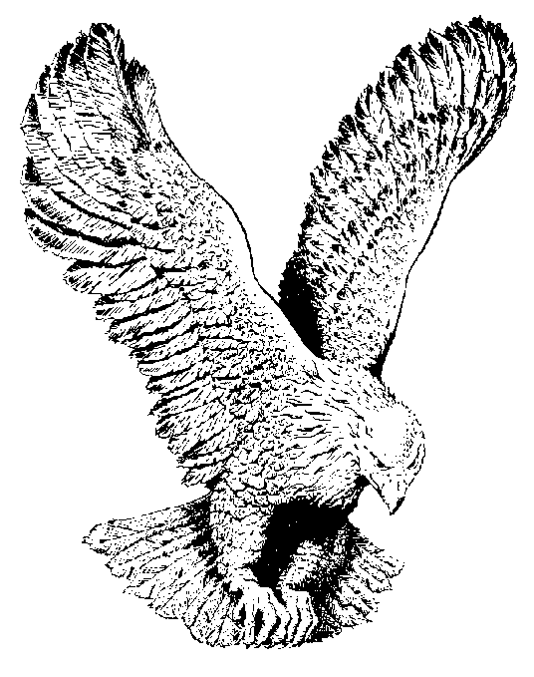
BORN, BORN, BORN AGAIN
Born, born, born again
Thank God I’m born again,
Born, born, born again,
Thank God I’m born again,
Born of the water
And the Spirit and the blood
Thank God I’m born again,
Born of the water
And the Spirit and the blood
Thank God I’m born again.

